Slide 1
Numerical Linear Algebra meets Machine Learning
Fabian Koffer, Simon Hanselmann, Yannick Funk,
Dennis Leon Grötzinger, Anna Ricker

Slide 2
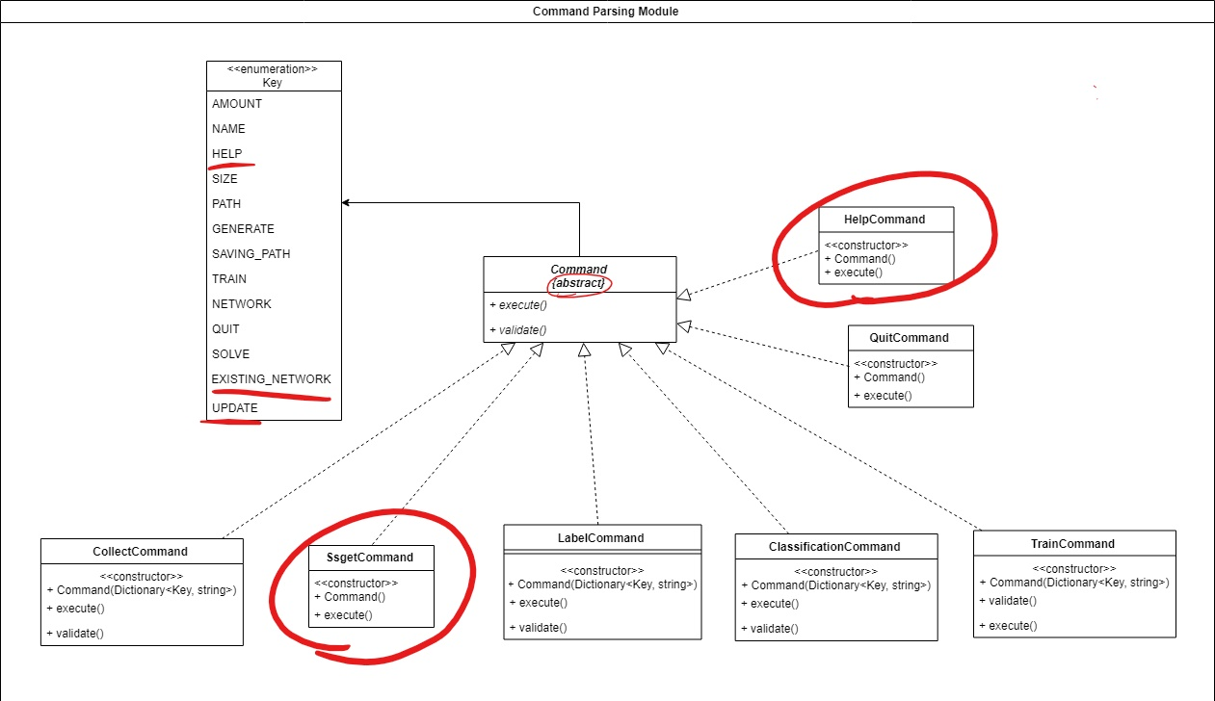
Changes of the design
Notes:
-changed the command interface to an abstract class: to reduce redundancy of the code
-let out the possibility to select a density: couldn't guarantee that the fetched and cut matrices from Suite Sparse have the wanted density
-added a help command: so the user is able to get an overview which commands can be executed
-added a Ssget command: so the user is able to update the file, where all the matrices ID's are listed

Slide 3
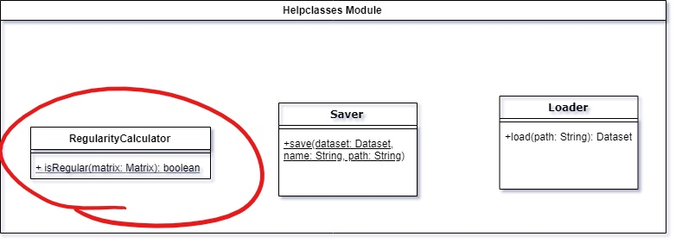
Changes of the design
Notes:
-didn‘t implemented a matrix class: decided it‘s not usefull to handle every matrix by it‘s own -> instead: numpy arrays
-renamed validator class to RegularityCalculator

Slide 4
What was implemented?
Accomplished as far as possible:
cross-platformed compatibility
Matrices can just fetch and cut from Suite Sparse, but not generated
let out the possibility to select a density
Notes:
-cross-plattformed: not possible, because some used entities (ssget, gingko) where not Windows compatible.
-Just fetch/cut: we realized we dont have enough knowledge yet to generate and there are not much suite sparse matrices in one size -> fetch and cut
-density: we couldn't guarantee that the fetched and cut matrices from Suite Sparse have the wanted density.

Slide 5
What was implemented?
This optional requirements were implemented:
The software is able to utilize GPU accelerators for the training and prediction capabilities of the neural network
The system just supports four instead of five iterative solver algorithms
This optional requirements were dropped:
A web interface to the software
Scalability of the workflow including matrix generation, training, prediction in that multiple processors may be used in parallel.
Notes:
Just four solvers: one solver was not working properly

Slide 6
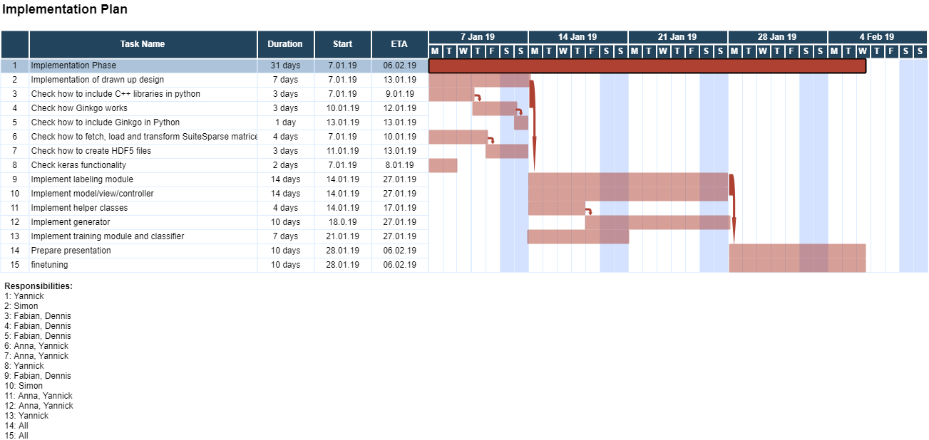
Time schedule
Notes:
Delays:
Labeling module → training/classifier

Slide 7
Delays and problems
Labeling module:
Little documentation made it hard to use Ginkgo
It was difficult integrating C++
Training/classify module:
Delay in the implementation of the training and classify module, because of the labelling module
Notes:
Training/classify-Delay, because of labeling problems

Slide 8
Statistics
Lines of python code: 1500
Lines of C++ code: 200
Commits: 200
Test coverage: 80%
Work splitting:
Collector: Yannik and Anna
Labeler: Dennis and Fabian
Training module, Classifier, Help classes: Yannick
Command parsing and output service module: Simon
Implementation report: Anna

Slide 9
Development model
Communication in the team
One to two meetings per week
GIT:
Merging on the master was destricted
Create a pull request
Colleagues have to review the changes
Travis (required)
CodeClimate (optional)
Notes:
Merging: branch need to be up to date → pull request →colleagues review or suggest changes
Travis(required): shows if tests are succesful
Codeclimate: looks at the code →decide how readable and complex the code, is PEP8 conform and shows test coverage
codeclimate is optional because we hadn’t time to clean up some code passages (like labeller)

Slide 10
